Slide 1
OS Info

Slide 2
Linux Commands Used in This Lab
Command | Purpose | Command Syntax Used | Explanation
mmls | To display the partition layout of a disk image. | mmls disk_image.img | Display partition layout of disk image named disk_image.img
losetup | To set up loop devices. Loop devices are often used to mount filesystems stored in regular files for testing or recovery purposes | losetup -fP /path/to/disk_image.img | -f => automatically find the first available loop device -P => automatically create and associate the loop device with all partitions within the specified file
lsblk | To list information about block devices. | lsblk /dev/loop0 | Display all information about loop device at loop0 including partitions
mount | To attach a filesystem (a collection of files and directories) to a specific directory | mount /dev/loop0p21 /mnt/mydisk | Mount source (loop device at loop0p21) to mount point (/mnt/mydisk)

Slide 3
Where to Find OS Information
OS & Other Info is in build.prop file
The build.prop file holds OS information.
Located in the /system directory on the 'system' partition.
Full path: /system/build.prop.
Requires elevated permissions ("root" access) obtained with sudo su.
Contents of build.prop
Various system properties and configuration settings.
Defines characteristics and behavior of the operating system.

Slide 4
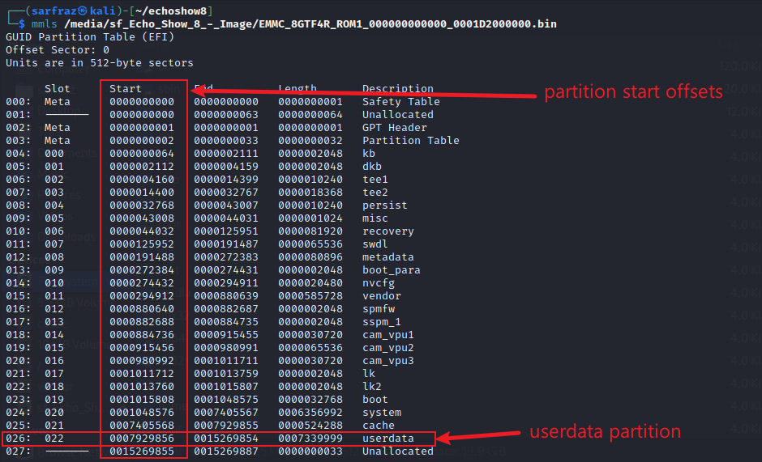
Display Partitions of the eMMC Image
List partitions of Image
There are 23 partitions in the disk image of eMMC of Echo Show 8 Device
Total size of image is 7.3 GB
Largest two partitions are
Userdata 3.5 GB
System 3 GB
OS Information is in System Partition
All other device & user info is in userdata partition

Slide 5
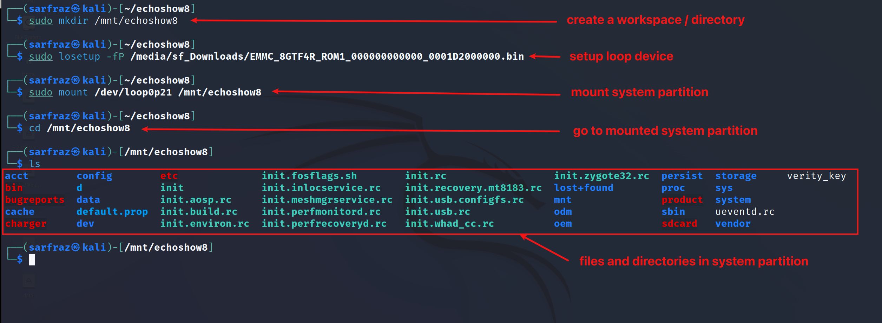
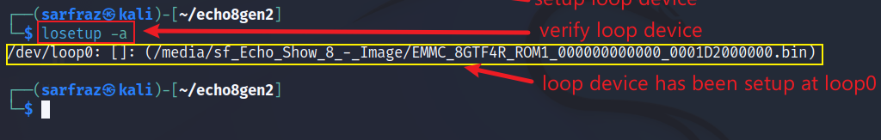
To find OS Info Mount ‘System’ Partition
Create directory (mount point) and setup loop device
Check/show all loop devices

Slide 6
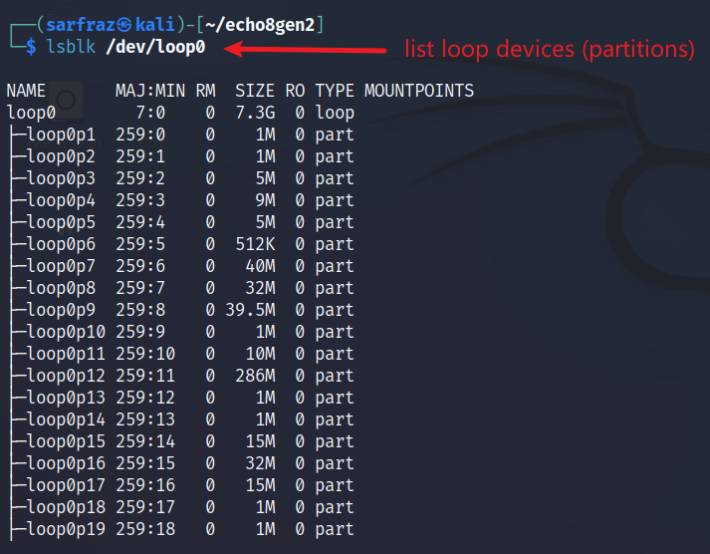
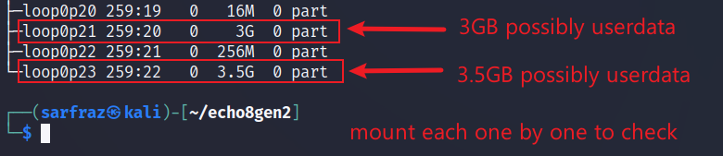
Check Partition Numbers of Block Devices
List loop devices

Slide 7
To find OS Info Mount ‘System’ Partition
Mount loop0p21 (system partition) to mount point (/mnt/echoshow8)

Slide 8
To find OS Info Mount ‘System’ Partition
Create directory, setup loop device and mount

Slide 9
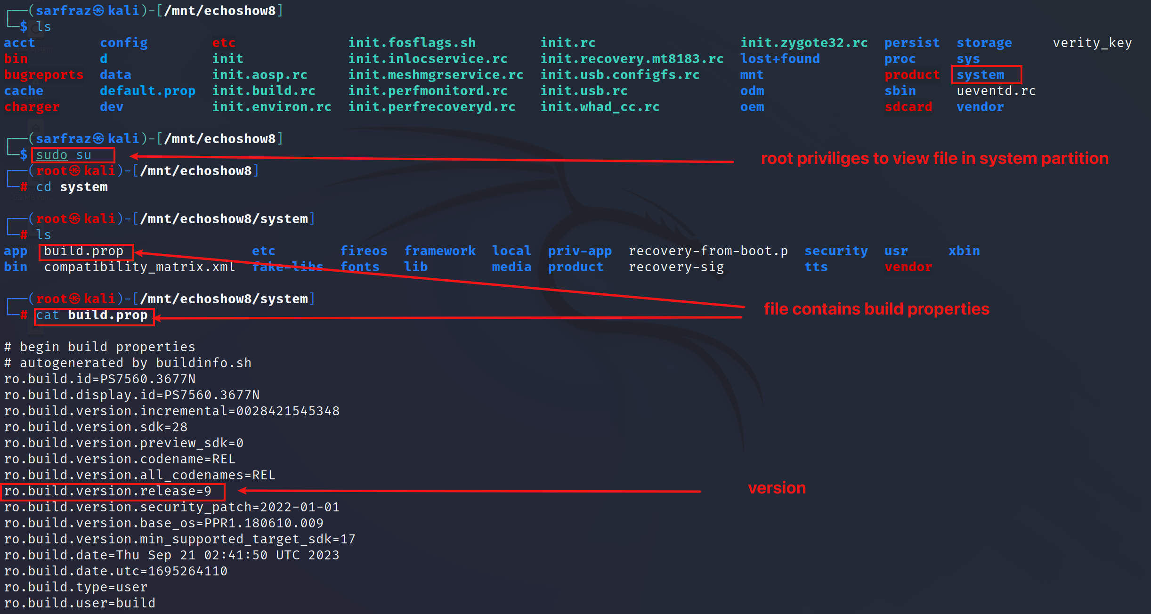
Display the Contents of the build.prop File
Go to system directory and view build.prop file
Build.prop file contains configuration properties related to the system

Slide 10

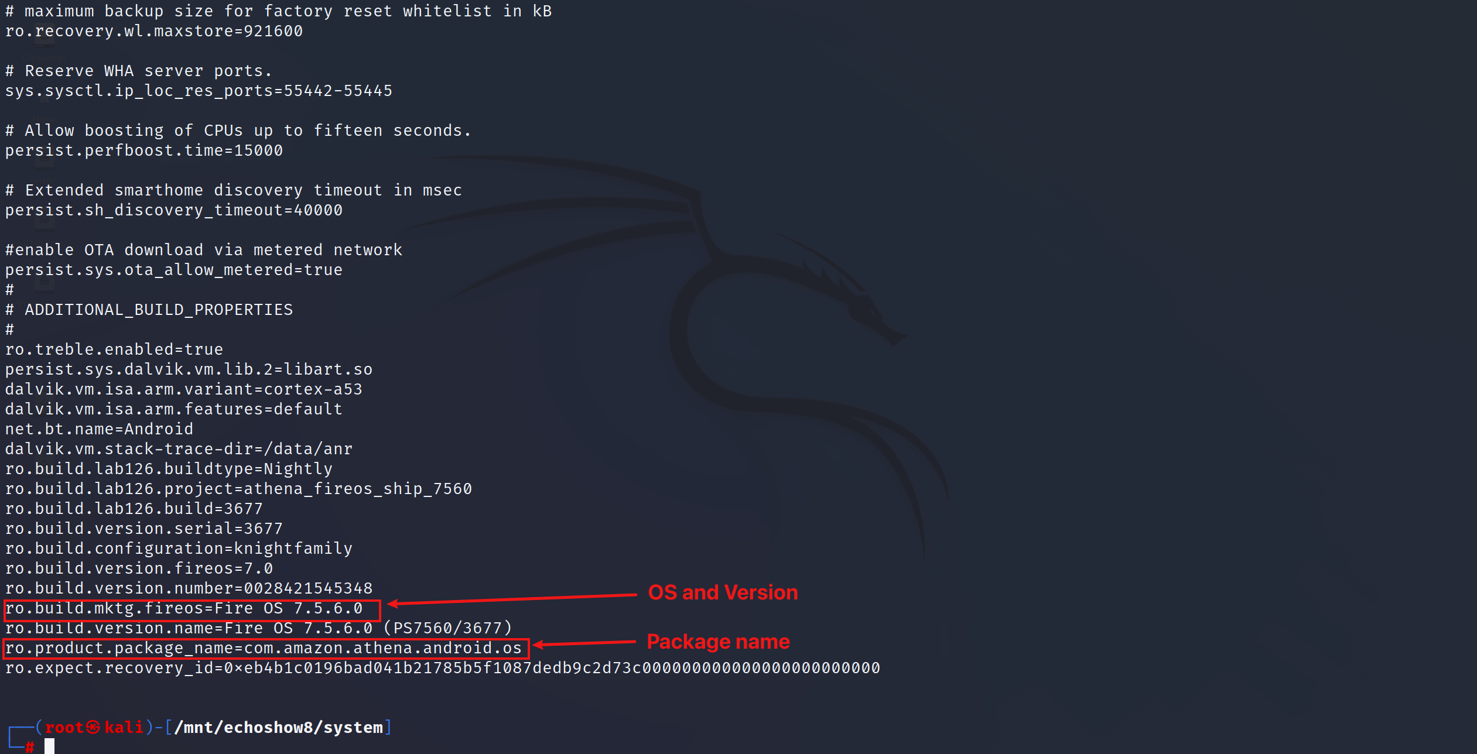
OS Info Found in ‘build.prop’ File
Create directory, setup loop device and mount

Slide 11
Important Information from build.prop
Configuration Property | Name | Value | Explanation
Android Version Release | ro.build.version.release | 9 | Android version release number
Security Patch Date | ro.build.version.security_patch | 01/01/2022 | Date of the Android security patch
Build Date | ro.build.date | Thu Sep 21 02:41:50 UTC 2023 | Date and time of the build creation
Product Model | ro.product.model | AEOAT | Model of the product
Product Brand | ro.product.brand | Amazon | Brand of the product
CPU ABI | ro.product.cpu.abi | armeabi-v7a | CPU architecture
Manufacturer | ro.product.manufacturer | Amazon | Manufacturer of the product
Locale | ro.product.locale | en-US | Locale setting
Fire OS Version | ro.build.version.fireos | 7 | Fire OS version
Build Number | ro.build.version.number | 28421545348 | Build number
Fire OS Marketing Version | ro.build.mktg.fireos | Fire OS 7.5.6.0 | Marketing version of Fire OS
Package Name | ro.product.package_name | com.amazon.athena.android.os | Package name of the product

Slide 12
Fire OS Vs Android
Fire OS is a customized version of Android developed by Amazon for its Fire devices, like the Echo Show series.
The Fire OS is Android-based, but it has its own app store and ecosystem.
Amazon customizes and pre-installs certain apps on its Fire devices.

Slide 13
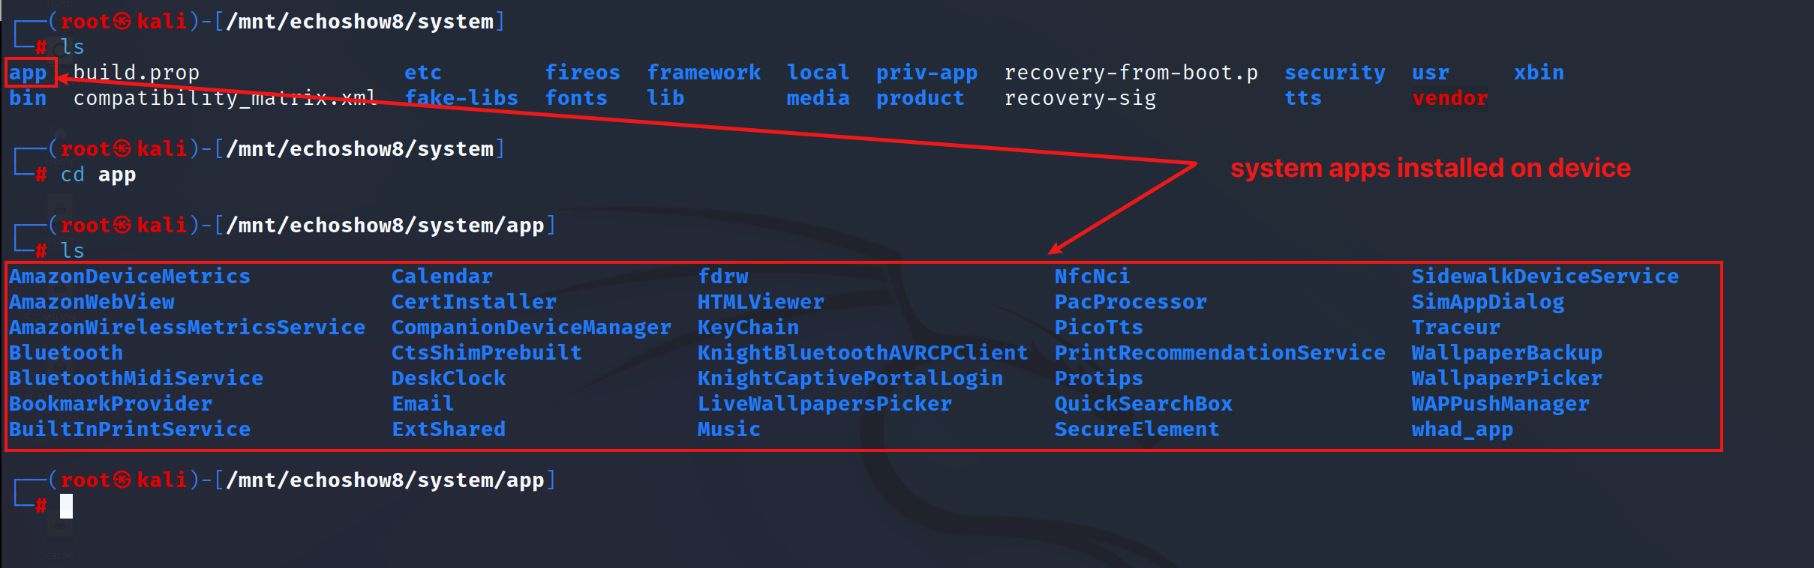
Installed System Apps on the Device
Go to ‘app’ directory and list files/directories

Slide 14
Device Info

Slide 15
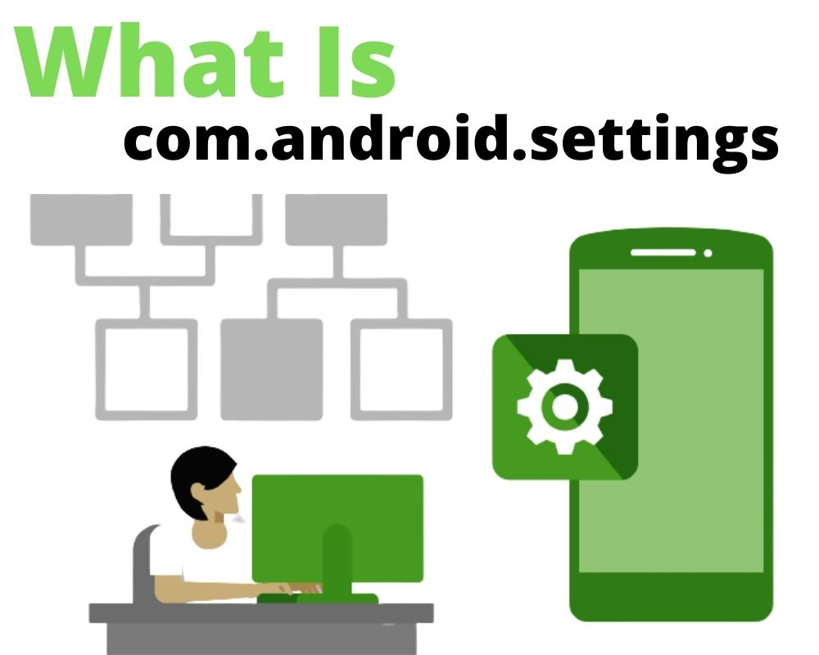
Where to Find Device Info – com.android.settings
The com.android.settings package is associated with the system settings application.
It provides a user interface for managing various settings on the device.
Users can access and configure a wide range of options related to connectivity, display, sound, security, accounts, and more through the Settings app.
It contains settings and info about
Wireless & Networks
Device
Personal
System
About Device/Phone
Image Source: What Is Com.android.settings App? and How to Fix it? (grouphowto.com)

Slide 16
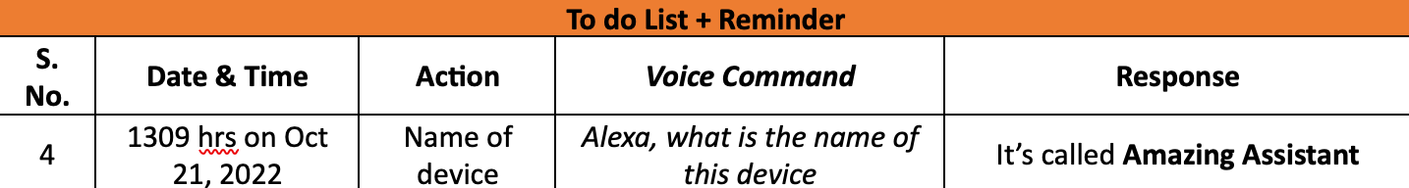
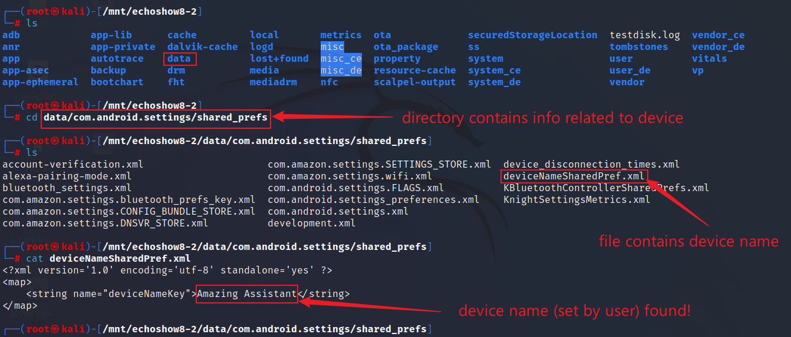
Device Name
Go to data.com.android.settings/shared_prefs & view deviceNameSharedPref.xml file

Slide 17
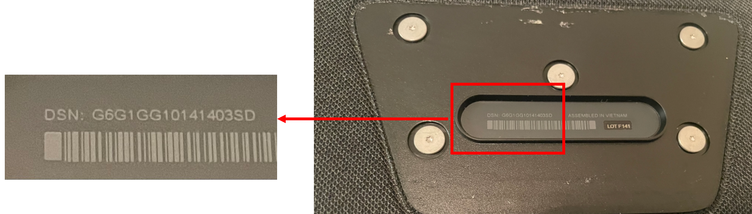
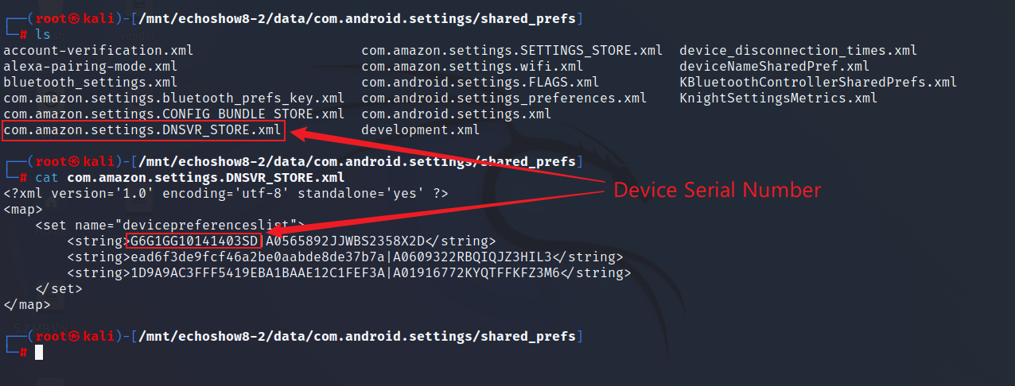
Device Serial Number
View com.amazon.settings.DNSVR_STORE.xml file

Slide 18
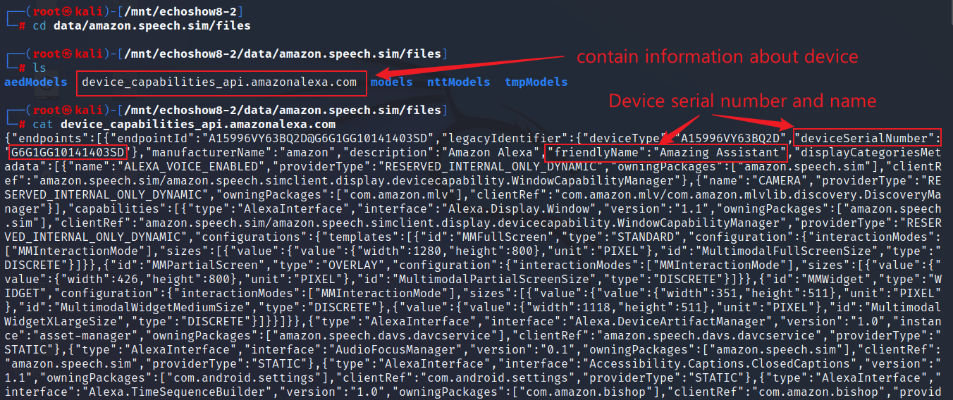
Device Name and Serial Number
Device name and Serial Number can be found in amazon.speech.sim app also which is a simulator that allows you to test applications
View device_capabilities_api.amazonalexa.com file

Slide 19
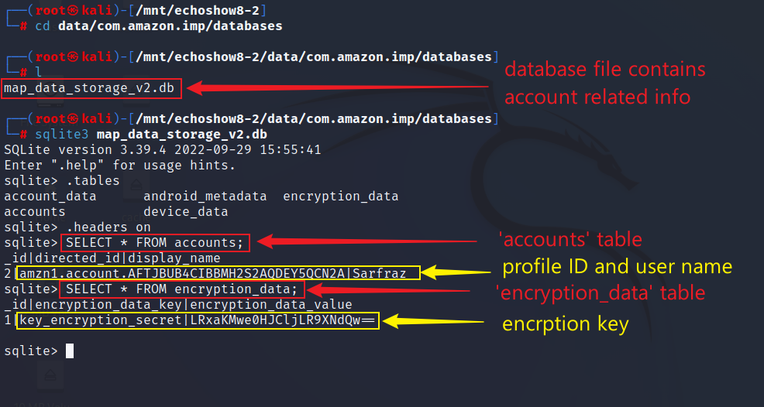
Profile ID, User’s Name and Encryption Key
View map_data_storage_v2.db file in com.amazon.imp
The app com.amazon.imp is responsible for displaying ads on the device’s home screen and sending data to Amazon about usage

